Slide 1
Foundations of Modern Networking
SDN, NFV, and Cloud
By: William Stallings

Slide 2
Chapter 1
Elements of Modern Networking
Notes:
Chapter Objectives
After studying this chapter, you should be able to
■ Explain the key elements and their relationships of a modern networking ecosystem, including end users, network providers, application providers and application service providers.
■ Discuss the motivation for the typical network hierarchy of access networks, distribution networks, and core networks.
■ Present an overview of Ethernet, including a discussion of its application areas and
common data rates.
■ Present an overview of Wi-Fi, including a discussion of its application areas and common data rates.
■ Understand the differences between the five generations of cellular networks.
■ Present an overview of cloud computing concepts.
■ Describe the Internet of Things.
■ Explain the concepts of network convergence and unified communications.

Slide 3
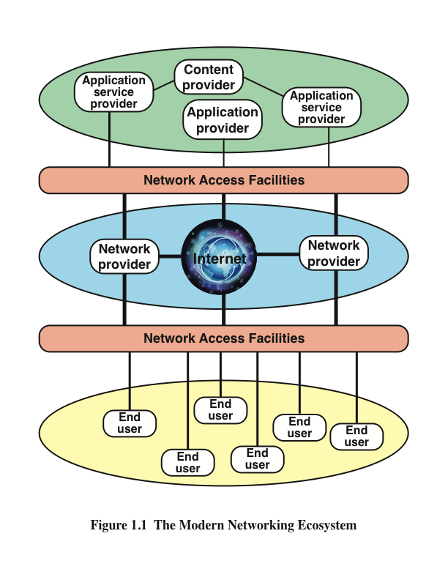
Notes:
Figure 1.1 depicts the modern networking ecosystem in very general terms. The entire
ecosystem exists to provide services to end users. The term end user , or simply user ,
is used here as a very general term, to encompass users working within an enterprise
or in a public setting or at home. The user platform can be fixed (for example, PC
or workstation), portable (for example, laptop), or mobile (for example, tablet or
smartphone).
Users connect to network-based services and content through a wide variety of
network access facilities. These include digital subscriber line (DSL) and cable
modems, Wi-Fi and Worldwide Interoperability for Microwave Access (WiMAX)
wireless modems, and cellular modems. Such network access facilities enable the use
to connect directly to the Internet or to a variety of network providers, including Wi-Fi
networks, cellular networks, and both private and shared network facilities, such as a
premises enterprise network.
Ultimately, of course, users want to use network facilities to access applications and
content. Figure 1.1 indicates three broad categories of interest to users. Application
providers provide applications, or apps, that run on the user’s platform, which is
typically a mobile platform. More recently, the concept of an app store has become
available for fixed and portable platforms as well.
A distinct category of provider is the application service provider . Whereas
the application provider downloads software to the user’s platform, the application
service provider acts as a server or host of application software that is executed on
the provider’s platforms. Traditional examples of such software include web servers,
e-mail servers, and database servers. The most prominent example now is the cloud
computing provider. We discuss this latter category subsequently in this chapter and
in Chapter 13, “Cloud Computing.”
The final element shown in Figure 1.1 is the content provider . A content provider
serves the data to be consumed on the user device (for example, e-mail, music, video).
This data may be commercially provided intellectual property. In some instances, an
enterprise may be an application or content provider. Examples of content providers
are music record labels and movie studios.
Figure 1.1 is intended to provide a very general depiction of the networking ecosystem.
It is worth pointing out here two major elements of modern networking not explicitly
depicted in this figure:
■ Data center networking: Both large enterprise data centers and cloud
provider data centers consist of very large numbers of interconnected servers.
Typically, as much as 80 percent of the data traffic is within the data center
network, and only 20 percent relies on external networks to reach users.
■ IoT or fog networking: An Internet of Things deployed by an enterprise
may consist of hundreds, thousands, even millions of devices. The vast bulk
of the data traffic to and from these devices is machine to machine, rather than
user to machine.
Each of these networking environments creates its own particular requirements, which
are discussed as the book progresses.

Slide 4
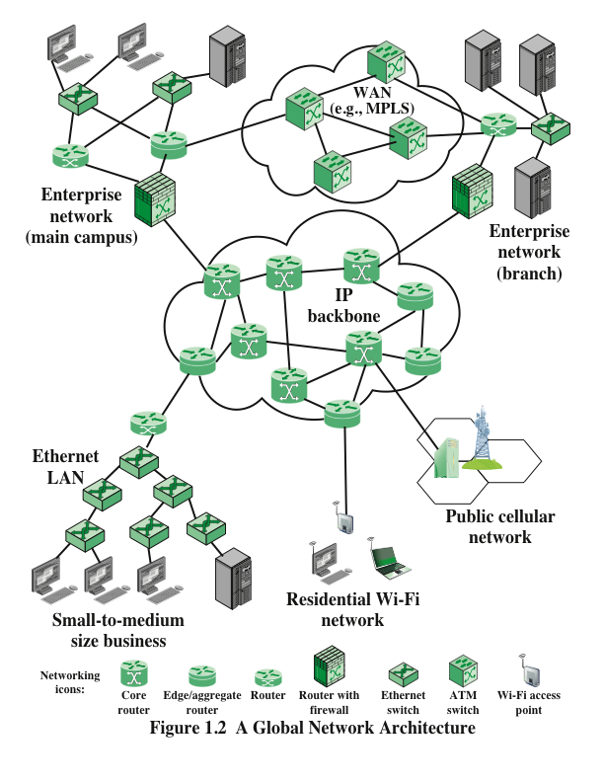
Notes:
We begin with an architecture that could represent an enterprise network of national
or global extent, or a portion of the Internet with some of its associated networks.
Figure 1.2 illustrates some of the typical communications and network elements in use
in such a context.
At the center of the figure is an IP backbone, or core, network, which could represent
a portion of the Internet or an enterprise IP network. Typically, the backbone consists
of high-performance routers, called core routers , interconnected with high-volume
optical links. The optical links often make use of what is known as wavelength division
multiplexing (WDM), such that each link has multiple logical channels
occupying different portions of the optical bandwidth.
At the periphery of an IP backbone are routers that provide connectivity to external
networks and users. These routers are sometimes referred to as edge routers or
aggregation routers . Aggregation routers are also used within an enterprise
network to connect a number of routers and switches, to external resources, such as
an IP backbone or a high-speed WAN. As an indication of the capacity requirements
for core and aggregation routers, the IEEE Ethernet Bandwidth Assessments Group
[XI11] reports on an analysis that projects these requirements for Internet backbone
providers and large enterprise networks in China. The analysis concludes that
aggregation router requirements will be in the range of 200 Gbps to 400 Gbps per
optical link by 2020, and 400 Gbps to 1 Tbps per optical link for core routers by 2020.
The upper part of Figure 1.2 depicts a portion of what might be a large enterprise
network. The figure shows two sections of the network connected via a private highspeed
WAN, with switches interconnected with optical links. MPLS using IP is a
common switching protocol used for such WANs; wide-area Ethernet is another
option. Enterprise assets are connected to, and protected from, an IP backbone or
the Internet via routers with firewall capability, a not uncommon arrangement for
implementing the firewall.
The lower left of the figure depicts what might be a layout for a small- or medium-size
business, which relies on an Ethernet LAN. Connection to the Internet through a
router could be through a cable or DSL connection or a dedicated high-speed link.
The lower portion of Figure 1.2 also shows an individual residential user connected
to an Internet service provider (ISP) through some sort of subscriber connection.
Common examples of such a connection are a DSL, which provides a high-speed
link over telephone lines and requires a special DSL modem, and a cable TV facility,
which requires a cable modem, or some type of wireless connection. In each case,
there are separate issues concerning signal encoding, error control, and the internal
structure of the subscriber network.
Finally, mobile devices, such as smartphones and tablets, can connect to the Internet
through the public cellular network, which has a high-speed connection, typically
optical, to the Internet.

Slide 5
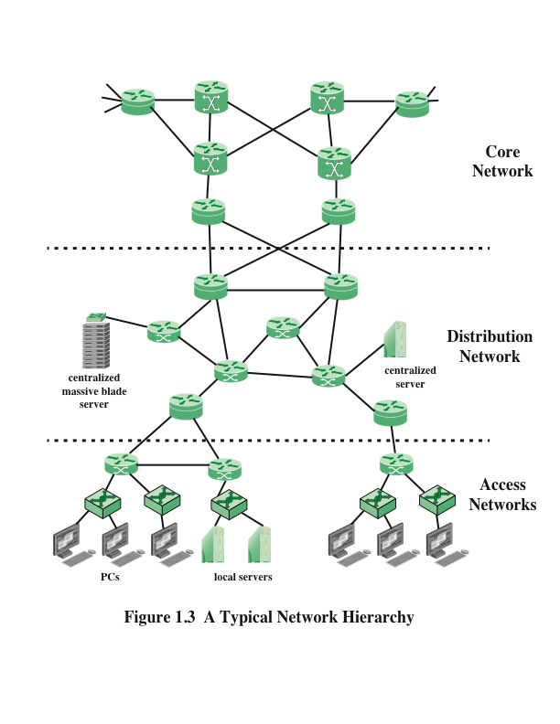
Notes:
As Figure 1.3 illustrates, enterprises often design their network
facilities in a three-tier hierarchy: access, distribution, and core.
Closest to the end user is the access network . Typically, an access network is a
local-area network (LAN) or campus-wide network that consisting of LAN switches
(typically Ethernet switches) and, in larger LANs, IP routers that provide connectivity
among the switches. Layer 3 switches (not shown) are also commonly used within
an LAN. The access network supports end user equipment, such as desktop and laptop
computers and mobile devices. The access network also supports local servers that
primarily or exclusively serve the users on the local access network.
One or more access routers connect the local assets to the next higher level of the
hierarchy, the distribution network. This connection may be via the Internet or some
other public or private communications facility. Thus, as described in the preceding
subsection, these access routers function as edge routers that forward traffic into and
out of the access network. For a large local facility, there might be additional access
routers that provide internal routing but do not function as edge routers (not shown in
Figure 1.2).
The distribution network connects access networks with each other and with the
core network. An edge router in the distribution network connects to an edge router in
an access network to provide connectivity. The two routers are configured to recognize
each other and will generally exchange routing and connectivity information and,
typically, some traffic-related information. This cooperation between routers is referred
to as peering . The distribution network also serves to aggregate traffic destined for
the core router, which protects the core from high-density peering. That is, the use of
a distribution network limits the number of routers that establish peer relationships
with edge routers in the core, saving memory, processing, and transmission capacity.
A distribution network may also directly connect servers that are of use to multiple
access networks, such as database servers and network management servers.
Again, as with access networks, some of the distribution routers may be purely internal
and do not provide an edge router function.
The core network , also referred to as a backbone network , connects
geographically dispersed distribution networks as well as providing access to other
networks that are not part of the enterprise network. Typically, the core network will
use very high performance routers, high-capacity transmission lines, and multiple
interconnected routers for increased redundancy and capacity. The core network
may also connect to high-performance, high-capacity servers, such as large database
servers and private cloud facilities. Some of the core routers may be purely internal,
providing redundancy and additional capacity without serving as edge routers.
A hierarchical network architecture is an example of a good modular design. With
this design, the capacity, features, and functionality of network equipment (routers,
switches, network management servers) can be optimized for their position in the
hierarchy and the requirements at a given hierarchical level.

Slide 6
Ethernet
Predominant wired networking technology
Has evolved to support data rates up to 100Gbps
Supports distances from a few meters to tens of kilometers
Has become essential for supporting personal computers, workstations, servers, and massive data storage devices in organizations large and small
Notes:
Ethernet is the predominant wired networking technology, used in homes, offices,
data centers, enterprises, and WANs. As Ethernet has evolved to support data rates
up to 100 Gbps and distances from a few meters to tens of kilometers, it has become
essential for supporting personal computers, workstations, servers, and massive data
storage devices in organizations large and small.

Slide 7
Ethernet in the Home
Has been used to create a local network of computers with access to the Internet via a broadband modem/router
Has declined with increasing availability of high-speed, low-cost Wi-Fi
Two recent extensions of Ethernet technology have enhanced and broadened the use of Ethernet in the home
Powerline carrier (PLC)
Power over Ethernet (PoE)
Notes:
Ethernet has long been used in the home to create a local network of computers with
access to the Internet via a broadband modem/router. With the increasing availability
of high-speed, low-cost Wi-Fi on computers, tablets, smartphones, modem/routers,
and other devices, home reliance on Ethernet has declined. Nevertheless almost all
home networking setups include some use of Ethernet.
Two recent extensions of Ethernet technology have enhanced and broadened the use
of Ethernet in the home: powerline carrier (PLC) and Power over Ethernet (PoE).
Powerline modems take advantage of existing power lines and use the power wire
as a communication channel to transmit Ethernet packets on top of the power signal.
This makes it easy to include Ethernet-capable devices throughout the home into
the Ethernet network. PoE acts in a complementary fashion, distributing power over
the Ethernet data cable. PoE uses the existing Ethernet cables to distribute power to
devices on the network, thus simplifying the wiring for devices such as computers and
televisions.
With all of these Ethernet options, Ethernet will retain a strong presence in home
networking, complementing the advantages of Wi-Fi.

Slide 8
Ethernet in the Office
Has been the dominant network technology for wired local-area networks (LANs) in the office environment
Wired Ethernet technology exists side by side with the wireless Wi-Fi technology
Retains its popularity because:
It can support many devices at high speeds
Is not subject to interference
Provides a security advantage because it is resistant to eavesdropping
A combination of Ethernet and
Wi-Fi is the most common architecture
Notes:
Ethernet has also long been the dominant network technology for wired local-area
networks (LANs) in the office environment. Early on there were some competitors,
such as IBM’s Token Ring LAN and the Fiber Distributed Data Interface (FDDI), but
the simplicity, performance, and wide availability of Ethernet hardware eventually
made Ethernet the winner. Today, as with home networks, the wired Ethernet
technology exists side by side with the wireless Wi-Fi technology. Much of the traffic
in a typical office environment now travels on Wi-Fi, particularly to support mobile
devices. Ethernet retains its popularity because it can support many devices at high
speeds, is not subject to interference, and provides a security advantage because it
is resistant to eavesdropping. Therefore, a combination of Ethernet and Wi-Fi is the
most common architecture.

Slide 9
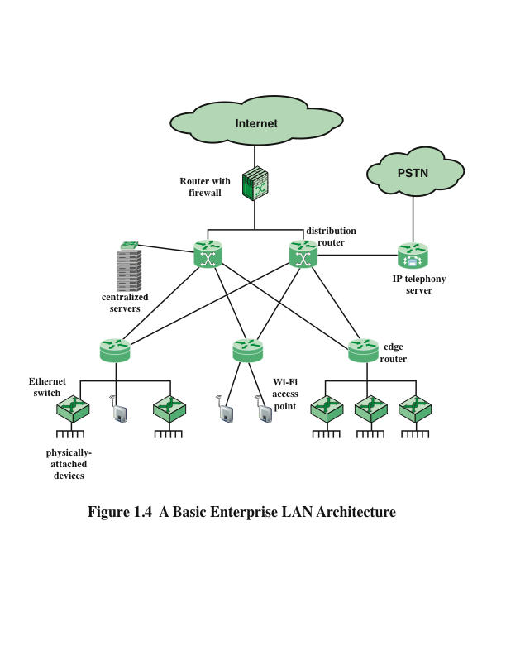
Notes:
Figure 1.4 provides a simplified example of an enterprise LAN architecture. The
LAN connects to the Internet/WANs via a firewall. A hierarchical arrangement of
routers and switches provides the interconnection of servers, fixed user devices, and
wireless devices. Typically, wireless devices are only attached at the edge or bottom
of the hierarchical architecture; the rest of the campus infrastructure is all Ethernet.
There may also be an IP telephony server that provides call control functions (voice
switching) for the telephony operations in an enterprise network, with connectivity to
the public switched telephone network (PTSN).

Slide 10
Ethernet in the Enterprise
Tremendous advantage of Ethernet is that it is possible to scale the network, both in terms of distance and data rate with the same Ethernet protocol and associated quality
An enterprise can easily extend an Ethernet network using a mixture of cable types and Ethernet hardware
Because all the hardware and communications software conform to the same standard it is easy to mix different speeds and different vendor equipment
Notes:
A tremendous advantage of Ethernet is that it is possible to scale the network, both
in terms of distance and data rate, with the same Ethernet protocol and associated
quality of service (QoS) and security standards. An enterprise can easily extend an
Ethernet network among a number of buildings on the same campus or even some
distance apart, with links ranging from 10 Mbps to 100 Gbps, using a mixture of cable
types and Ethernet hardware. Because all the hardware and communications software
conform to the same standard, it is easy to mix different speeds and different vendor
equipment. The same protocol is used for intensive high-speed interconnections of
data servers in a single room, workstations and servers distributed throughout the
building, and links to Ethernet networks in other buildings up to 100 km away.

Slide 11
Ethernet in the Data Center
Has come to dominate in the data center where very high data rates are needed to handle massive volumes of data among networked servers and storage units
For co-located servers and storage units, high-speed Ethernet fiber links and switches provided the needed networking infrastructure
Backplane Ethernet
Runs over copper jumper cables that can provide up to 100 Gbps over very short distances
Blade servers
Multiple server modules housed in a single chassis
Notes:
As in other areas, Ethernet has come to dominate in the data center, where very high
data rates are needed to handle massive volumes of data among networked servers
and storage units. Historically, data centers have employed various technologies to
support high-volume, short-distance needs, including InfiniBand and Fiber Channel.
But now that Ethernet can scale up to 100 Gbps, with 400 Gbps on the horizon, the
case for a unified protocol approach throughout the enterprise is compelling.
Two features of the new Ethernet approach are noteworthy. For co-located servers
and storage units, high-speed Ethernet fiber links and switches provided the needed
networking infrastructure. Another important version of Ethernet is known as
backplane Ethernet. Backplane Ethernet runs over copper jumper cables that can
provide up to 100 Gbps over very short distances. This technology is ideal for blade
servers , in which multiple server modules are housed in a single chassis.

Slide 12
Ethernet for Wide-Area Networking
Until recently Ethernet was not a significant factor in wide-area networking
Gradually more telecommunications and network providers have switched to Ethernet from alternative schemes to support wide-area access
Other wide-area options
Dedicated T1 lines
Synchronous digital hierarchy (SDH) lines
Asynchronous Transfer Mode (ATM)
Carrier Ethernet
One of the fastest-growing Ethernet technologies
Notes:
Until fairly recently, Ethernet was not a significant factor in wide-area networking.
But gradually, more telecommunications and network providers have switched to
Ethernet from alternative schemes to support wide-area access (also referred to as first
mile or last mile). Ethernet is supplanting a variety of other wide-area options, such
as dedicated T1 lines, synchronous digital hierarchy (SDH) lines, and Asynchronous
Transfer Mode (ATM). When used in this fashion, the term carrier Ethernet is
applied. The term metro Ethernet , or metropolitan-area network (MAN) Ethernet , is
also used. Ethernet has the advantage that it seamlessly fits into the enterprise network
for which it provides wide-area access. But a more important advantage is that carrier
Ethernet provides much more flexibility in terms of the data rate capacity that is used,
compared to traditional wide-area alternatives.
Carrier Ethernet is one of the fastest-growing Ethernet technologies, destined to
become the dominant means by which enterprises access wide-area networking and
Internet facilities.

Slide 13
Standards
IEEE 802 LAN standards committee
802.3 group is responsible for issuing standards for LANs that are referred to commercially as Ethernet
The Ethernet Alliance supports and originates activities that span from incubation of new Ethernet technologies to interoperability testing to demonstrations to education
Notes:
Within the IEEE 802 LAN standards committee, the 802.3 group is responsible
for issuing standards for LANs that are referred to commercially as Ethernet.
Complementary to the efforts of the 802.3 committee, the industry consortium known
as The Ethernet Alliance supports and originates activities that span from incubation of
new Ethernet technologies to interoperability testing to demonstrations to education.

Slide 14
Ethernet Data Rates
1983
1995
1998
2003
2010
10 Mbps
100 Mbps
1 Gbps
10 Gbps
40 Gbps and 100 Gbps
Currently Ethernet systems are available at speeds up to 100 Gbps
Notes:
Currently, Ethernet systems are available at speeds up to 100 Gbps. Here’s a brief
chronology.
■ 1983: 10 Mbps (megabit per second, million bits per second)
■ 1995: 100 Mbps
■ 1998: 1 Gbps (gigabits per second, billion bits per second)
■ 2003: 10 Gbps
■ 2010: 40 Gbps and 100 Gbps

Slide 15
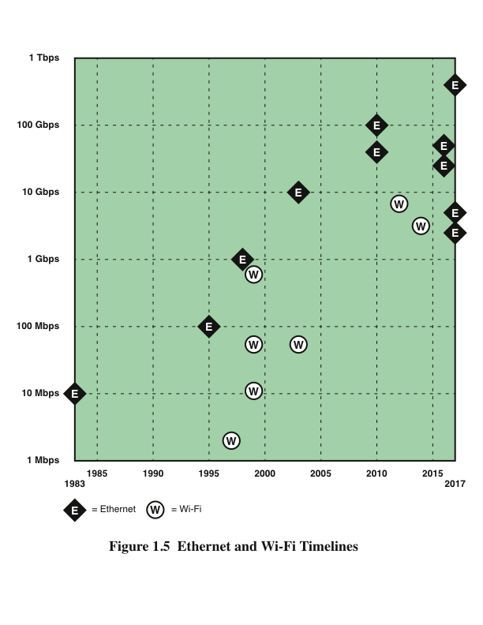

Slide 16
1-Gbps Ethernet
Centralized server farms
In many multimedia applications there is a need for client systems to be able to draw huge amounts of data from multiple centralized servers, called server farms
High-speed local backbone
As processing demand grows, enterprises develop an architecture of multiple LANs interconnected with a high-speed backbone network
Power workgroups
These groups typically consist of a small number of cooperating users who need to exchange massive data files across the network
Example applications are software development and computer-aided design
Notes:
For a number of years, the initial standard of Ethernet, at 10 Mbps, was adequate for
most office environments. By the early 1990s, it was clear that higher data rates were
needed to support the growing traffic load on the typical LAN. Key drivers included
the following:
■ Centralized server farms: In many multimedia applications, there is a
need for client system to be able to draw huge amounts of data from multiple,
centralized servers, called server farms. As the performance of the servers has
increased, the network becomes the bottleneck.
■ Power workgroups: These groups typically consist of a small number of
cooperating users who need to exchange massive data files across the network.
Example applications are software development and computer-aided design.
■ High-speed local backbone: As processing demand grows, enterprises
develop an architecture of multiple LANs interconnected with a high-speed
backbone network.
To meet such needs, the IEEE 802.3 committee developed a set of specifications for
Ethernet at 100 Mbps, followed a few years later by a 1-Gbps family of standards.
In each case, the new specifications defined transmission media and transmission
encoding schemes built on the basic Ethernet framework, making the transition easier
than if a completely new specification were issued.

Slide 17
10-Gbps Ethernet
The principle driving requirement for 10-Gbps Ethernet was the increase in intranet and Internet traffic
Factors contributing to the explosive growth in both Internet and intranet traffic:
An increase in the number of network connections
An increase in the connection speed of each end-station
An increase in the deployment of bandwidth-intensive applications such as high-quality video
An increase in web hosting and application hosting traffic
Notes:
Even as the ink was drying on the 1-Gbps specification, the continuing increase in
local traffic made this specification inadequate for needs in the short-term future.
Accordingly, the IEEE 802.3 committee soon issued a standard for 10-Gbps Ethernet.
The principle driving requirement for 10-Gbps Ethernet was the increase in intranet
(local interconnected networks) and Internet traffic. A number of factors contribute to
the explosive growth in both Internet and intranet traffic:
■ An increase in the number of network connections
■ An increase in the connection speed of each end-station (for example, 10-Mbps
users moving to 100 Mbps, analog 56k users moving to DSL and cable
modems)
■ An increase in the deployment of bandwidth-intensive applications such as
high-quality video
■ An increase in web hosting and application hosting traffic
Initially, network managers used 10-Gbps Ethernet to provide high-speed, local
backbone interconnection between large-capacity switches. As the demand for
bandwidth increased, 10-Gbps Ethernet began to be deployed throughout the entire
network, to include server farm, backbone, and campus-wide connectivity. This
technology enables ISPs and network service providers (NSPs) to create very highspeed
links at a very low cost between co-located carrier-class switches and routers.
The technology also allows the construction of MANs and WANs that connect
geographically dispersed LANs between campuses or points of presence (PoPs).

Slide 18
100-Gbps Ethernet
Market drivers for 100-Gbps Ethernet
Data center/Internet media providers
To support the growth of Internet multimedia content and web applications, content providers have been expanding data centers
Metro video/service providers
Video on demand has been driving a new generation of 10-Gbps Ethernet
Enterprise LANs
Continuing growth in convergence of voice/video/data and in unified communications is driving up network switch demands
Internet exchanges/ISP core routing
With the massive amount of traffic flowing through these nodes, these installations are likely to be early adopters of 100-Gbps Ethernet
Notes:
The IEEE 802.3 committee soon realized the need for a greater data rate capacity than
10-Gbps Ethernet offers, to support Internet exchanges, high-performance computing,
and video-on-demand delivery. The authorization request justified the need for two
different data rates in the new standard (40 Gbps and 100 Gbps) by recognizing
that aggregate network requirements and end-station requirements are increasing at
different rates.
The following are market drivers for 100-Gbps Ethernet:
■ Data center/Internet media providers: To support the growth of Internet
multimedia content and web applications, content providers have been expanding
data centers, pushing 10-Gbps Ethernet to its limits. Likely to be highvolume
early adopters of 100-Gbps Ethernet.
■ Metro video/service providers: Video on demand has been driving a new
generation of 10-Gbps Ethernet metropolitan/core network buildouts. Likely to
be high-volume adopters in the medium term.
■ Enterprise LANs: Continuing growth in convergence of voice/video/data and
in unified communications is driving up network switch demands. However,
most enterprises still rely on 1-Gbps or a mix of 1-Gbps and 10-Gbps Ethernet,
and adoption of 100-Gbps Ethernet is likely to be slow.
■ Internet exchanges/ISP core routing: With the massive amount of traffic
flowing through these nodes, these installations are likely to be early adopters
of 100-Gbps Ethernet.

Slide 19
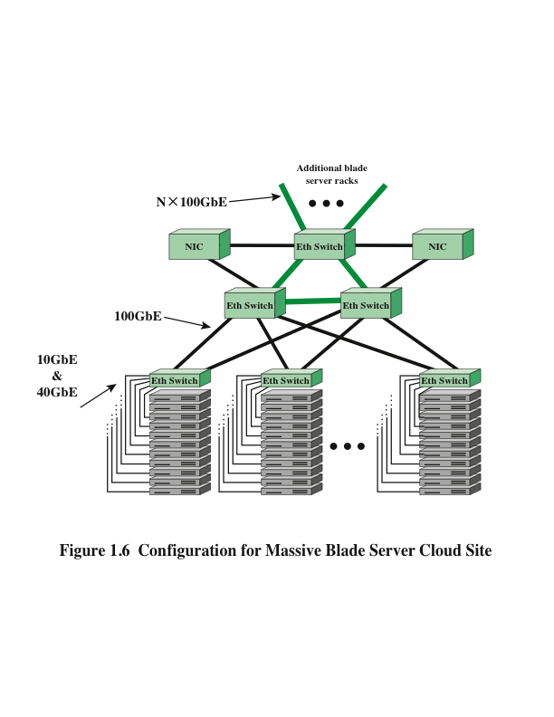
Notes:
Figure 1.6 shows an example of the application of 100-Gbps Ethernet. The trend
at large data centers, with substantial banks of blade servers, is the deployment of
10-Gbps ports on individual servers to handle the massive multimedia traffic provided
by these servers. Typically, a single blade server rack will contain multiple servers
and one or two 10-Gbps Ethernet switches to interconnect all the servers and provide
connectivity to the rest of the facility. The switches are often mounted in the rack and
referred to as top-of-rack (ToR) switches. The term ToR has become synonymous
with server access switch, even if it is not located “top of rack.” For very large data
centers, such as cloud providers, the interconnection of multiple blade server racks
with additional 10-Gbps switches is increasingly inadequate. To handle the increased
traffic load, switches operating at greater than 10 Gbps are needed to support the
interconnection of server racks and to provide adequate capacity for connecting offsite
through network interface controllers (NICs).

Slide 20
25/50 Gbps
25 Gigabit Ethernet Consortium
Includes Google and Microsoft
Objective is to support an industry standard, interoperable Ethernet specification that boosts the performance and slashes the interconnect cost per Gbps between the NIC and ToR switch
Prescribes a single-lane 25-Gbps Ethernet and dual-lane 50 Gbps Ethernet link protocol
IEEE 802.3 committee is at work developing the needed standards for 25 Gbps and may include 50 Gbps
Notes:
One of the options for implementing 100-Gbps is as four 25-Gbps physical lanes.
Therefore, it would be relatively easy to develop standards for 25-Gbps and 50-Gbps
Ethernet, using one or two lanes, respectively. Having these two lower-speed
alternatives, based on the 100-Gbps technology, would give users more flexibility
in meeting existing and near-term demands with a solution that would scale easily to
higher data rates.
Such considerations have led to the form of the 25 Gigabit Ethernet Consortium by a
number of leading cloud networking providers, including Google and Microsoft. The
objective of the Consortium is to support an industry-standard, interoperable Ethernet
specification that boosts the performance and slashes the interconnect cost per Gbps
between the NIC and ToR switch. The specification adopted by the Consortium
prescribes a single-lane 25-Gbps Ethernet and dual-lane 50-Gbps Ethernet link
protocol, enabling up to 2.5 times higher performance per physical lane on twinax
copper wire between the rack endpoint and switch compared to 10-Gbps and 40-Gbps
Ethernet links. The IEEE 802.3 committee is at work developing the needed standards
for 25 Gbps and may include 50 Gbps.
It is too early to say how these various options (25, 40, 50, 100 Gbps) will play
out in the marketplace. In the intermediate term, the 100-Gbps switch is likely to
predominate at large sites, but the availability of these slower and cheaper alternatives
gives enterprises a number of paths for scaling up to meet increasing demand.

Slide 21
400 Gbps Ethernet
2.5/5 Gbps Ethernet
These lower speeds are known as Multirate Gigabit BASE-T (MGBASE-T)
Currently the MGBASE-T Alliance is overseeing the development of these standards outside of IEEE
Mainly intended to support IEEE 802.11ac wireless traffic into a wired network
Gaining acceptance where more than 1 Gbps of throughput is needed (such as to support mobile users in the office environment)
IEEE 802.3 is currently exploring technology options for producing a 400-Gbps Ethernet standard
No timetable is yet in place
1-Tbps (terabits per second, trillion per second) standard will eventually be produced
Notes:
The growth in demand never lets up. IEEE 802.3 is currently exploring technology
options for producing a 400-Gbps Ethernet standard, although no timetable is yet
in place. Looking beyond that milestone, there is widespread acknowledgment that
a 1-Tbps (terabits per second, trillion bits per second) standard will eventually be
produced.
As a testament to the versatility and ubiquity of Ethernet, and at the same time that
ever higher data rates are being standardized, consensus is developing to standardize
two lower rates: 2.5 Gbps and 5 Gbps. These relatively low speeds are also known
as Multirate Gigabit BASE-T (MGBASE-T). Currently, the MGBASE-T Alliance is
overseeing the development of these standards outside of IEEE. It is likely that the
IEEE 802.3 committee will ultimately issue standards based on these industry efforts.
These new data rates are mainly intended to support IEEE 802.11ac wireless traffic
into a wired network. IEEE 802.11ac is a 3.2-Gbps Wi-Fi standard that is gaining
acceptance where more than 1 Gbps of throughput is needed, such as to support mobile
users in the office environment. This new wireless standard overruns 1-Gbps Ethernet
link support but may not require the next step up, which is 10 Gbps. Assuming that
2.5 and 5 Gbps can be made to work over the same cable that supports 1 Gbps, this
would provide a much needed uplink speed improvement for access points supporting
802.11ac radios with their high bandwidth capabilities.

Slide 22
Wi-Fi
Standardized by IEEE 802.11
Has become the dominant technology for wireless LANs
First important use was in the home to replace Ethernet cabling for connecting desktop and laptop computers with each other and with the Internet
Provides a cost effective way to the Internet
Is essential to implementing the Internet of Things (IoT)
Notes:
Just as Ethernet has become the dominant technology for wired LANs, so Wi-Fi ,
standardized by the IEEE 802.11 committee, has become the dominant technology for
wireless LANs. This overview section discusses applications of Wi-Fi and then looks
at standards and performance.
Wi-Fi is the predominant wireless Internet access technology, used in homes, offices,
and public spaces. Wi-Fi in the home now connects computers, tablets, smartphones,
and a host of electronic devices, such as video cameras, TVs, and thermostats. Wi-Fi
in the enterprise has become an essential means of enhancing worker productivity
and network effectiveness. And public Wi-Fi hotspots have expanded dramatically to
provide free Internet access in must public places.
The first important use of Wi-Fi in the home was to replace Ethernet cabling for
connecting desktop and laptop computers with each other and with the Internet. A
typical layout is a desktop computer with an attached router/modem that provides
an interface to the Internet. Other desktop and laptop computers connect either via
Ethernet or Wi-Fi to the central router, so that all the home computers can communicate
with each other and with the Internet. Wi-Fi greatly simplified the hookup. Not only
is there no need for a physical cable hookup, but the laptops can be moved easily from
room to room or even outside the house.
Today, the importance of Wi-Fi in the home has expanded tremendously. Wi-Fi
remains the default scheme for interconnecting a home computer network. Because
both Wi-Fi and cellular capability are now standard on both smartphones and tablets,
the home Wi-Fi provides a cost-effective way to the Internet. The smartphone or
tablet will automatically use a Wi-Fi connection to the Internet if available, and
only switch to the more expensive cellular connection if the Wi-Fi connection is not
available. And Wi-Fi is essential to implementing the latest evolution of the Internet:
the Internet of Things.

Slide 23
Public Wi-Fi
Hotspots have become readily available
Remote places can support hotspots with the development of the satellite Wi-Fi hotspot
First company to develop such a product was Iridium
The satellite modem will initially provide a relatively low-speed connection, but the data rates will inevitable increase
Notes:
Access to the Internet via Wi-Fi has expanded dramatically in recent years, as more
and more facilities provide a Wi-Fi hotspot, which enables any Wi-Fi device to attach.
Wi-Fi hotspots are provided in coffee shops, restaurants, train stations, airports,
libraries, hotels, hospitals, department stores, RV parks, and many other places.
So many hotspots are available that it is rare to be too far from one. There are now
numerous tablet and smartphone apps that increase their convenience.
Even very remote places will be able to support hotspots with the development of the
satellite Wi-Fi hotspot. The first company to develop such a product is the satellite
communications company Iridium. The satellite modem will initially provide a
relatively low-speed connection, but the data rates will inevitably increase.

Slide 24
Enterprise Wi-Fi
Economic benefit of Wi-Fi is most clearly seen in the enterprise
Approximately half of all enterprise network traffic is via Wi-Fi rather then the traditional Ethernet
Two trends have driven the transition to a Wi-Fi centered enterprise:
Demand has increased with more and more employees preferring to use laptops, tablets, and smartphones to connect to the enterprise network
The arrival of Gigabit Ethernet allows the enterprise network to support high-speed connections to mobile devices simultaneously
Notes:
The economic benefit of Wi-Fi is most clearly seen in the enterprise. Wi-Fi
connections to the enterprise network have been offered by many organizations of
all sizes, including public and private sector. But in recent years, the use of Wi-Fi
has expanded dramatically, to the point that now approximately half of all enterprise
network traffic is via Wi-Fi rather then the traditional Ethernet. Two trends have
driven the transition to a Wi-Fi-centered enterprise. First, the demand has increased,
with more and more employees preferring to use laptops, tablets, and smartphones
to connect to the enterprise network, rather than a desktop computer. Second, the
arrival of Gigabit Ethernet, especially the IEEE 802.ac standard, allows the enterprise
network to support high-speed connections to many mobile devices simultaneously.
Whereas Wi-Fi once merely provided an accessory network designed to cover
meetings and public areas, enterprise Wi-Fi deployment now generally provides
ubiquitous coverage, to include main offices and remote facilities, and both indoor
locations and outdoor spaces surrounding them. Enterprises accepted the need for, and
then began to encourage, the practice known as bring your own device (BYOD). The
almost universal availability of Wi-Fi capability on laptops, tablets, and smartphones,
in addition to the wide availability of home and public Wi-Fi networks, has greatly
benefited the organization. Employees can use the same devices and the same
applications to continue their work or check their e-mail from wherever they are—
home, at their local coffee shop, or while traveling. From the enterprise perspective,
this means higher productivity and efficiency and lower costs.

Slide 25
Standards
Interoperability is essential to the success of Wi-Fi
Wi-Fi enabled devices must be able to communicate with Wi-Fi access points regardless of the manufacturer of the device or access point
Interoperability is guaranteed by:
IEEE 802.11 wireless LAN committee develops the protocol and signaling standards
The Wi-Fi Alliance creates test suites to clarify interoperability for commercial products that conform to various IEEE 802.11 standards
The term Wi-Fi (wireless fidelity) is used for products certified by the Alliance
Notes:
Essential to the success of Wi-Fi is interoperability. Wi-Fi-enabled devices must be
able to communicate with Wi-Fi access points, such as the home router, the enterprise
access point, and public hotspots, regardless of the manufacturer of the device or
access point. Such interoperability is guaranteed by two organizations. First, the
IEEE 802.11 wireless LAN committee develops the protocol and signaling standards
for Wi-Fi. Then, the Wi-Fi Alliance creates test suites to certify interoperability for
commercial products that conform to various IEEE 802.11 standards. The term Wi-Fi
(wireless fidelity) is used for products certified by the Alliance.

Slide 26
Wi-Fi Data Rates
802.11 (1997): 2 Mbps (megabits per second, million bits per second)
802.11a (1999): 54 Mbps
802.11b (1999): 11 Mbps
802.11n (1999): 600 Mbps
802.11g (2003): 54 Mbps
802.11ad (2012): 6.76 Gbps (billion bits per second)
802.11ac (2014): 3.2 Gbps
Notes:
Just as businesses and home users have generated a need to extend the Ethernet
standard to speeds in the gigabits per second (Gbps) range, the same requirement
exists for Wi-Fi. As the technology of antennas, wireless transmission techniques, and
wireless protocol design has evolved, the IEEE 802.11 committee has been able to
introduce standards for new versions of Wi-Fi at ever-higher speeds. Once the standard
is issued, industry quickly develops the products. Here’s a brief chronology, starting
with the original standard, which was simply called IEEE 802.11, and showing the
maximum data rate for each version (Figure 1.5):
■ 802.11 (1997): 2 Mbps (megabits per second, million bits per second)
■ 802.11a (1999): 54 Mbps
■ 802.11b (1999): 11 Mbps
■ 802.11n (1999): 600 Mbps
■ 802.11g (2003): 54 Mbps
■ 802.11ad (2012): 6.76 Gbps (billion bits per second)
■ 802.11ac (2014): 3.2 Gbps
IEEE 802.11ac operates in the 5-GHz band, as does the older and slower standards
802.11a and 802.11n. It is designed to provide a smooth evolution from 802.11n.
This new standard makes use of advanced technologies in antenna design and signal
processing to achieve much greater data rates, at lower battery consumption, all within
the same frequency band as the older versions of Wi-Fi.
IEEE 802.11ad is a version of 802.11 operating in the 60-GHz frequency band.
This band offers the potential for much wider channel bandwidth than the 5-GHz
band, enabling high data rates with relatively simple signal encoding and antenna
characteristics. Few devices operate in the 60-GHz band, which means communication
experiences less interference than in the other bands used for Wi-Fi.
Because of the inherent transmission limitations of the 60-GHz band, 802.11ad is
likely to be useful only within a single room. Because it can support high data rates
and, for example, could easily transmit uncompressed high-definition video, it is
suitable for applications such as replacing wires in a home entertainment system, or
streaming high-definition movies from your cell phone to your television.
Gigabit Wi-Fi holds attractions for both office and residential environments and
commercial products are beginning to roll out. In the office environment, the demand
for ever greater data rates has led to Ethernet offerings at 10 Gbps, 40 Gbps, and most
recently 100 Gbps. These stupendous capacities are needed to support blade servers,
heavy reliance on video and multimedia, and multiple broadband connections offsite.
At the same time, the use of wireless LANs has grown dramatically in the office
setting to meet needs for mobility and flexibility. With the gigabit-range data rates
available on the fixed portion of the office LAN, gigabit Wi-Fi is needed to enable
mobile users to effectively use the office resources. IEEE 802.11ac is likely to be the
preferred gigabit Wi-Fi option for this environment.
In the consumer and residential market, IEEE 802.11ad is likely to be popular as a
low-power, short-distance wireless LAN capability with little likelihood of interfering
with other devices. IEEE 802.11ad is also an attractive option in professional media
production environments in which massive amounts of data need to be moved short
distances.

Slide 27
4G/5G Cellular
First Generation
1G
Original cellular networks
Provided analog traffic channels and were designed to be an extension of the public switched telephone networks
Most widely deployed system was the Advance Mobile Phone Service (AMPS) developed by AT&T
Voice transmission was purely analog and control signals were sent over a 10-kbps analog channel
Notes:
The original cellular networks, now dubbed 1G, provided analog traffic channels and
were designed to be an extension of the public switched telephone networks. Users
with brick-sized cell phones placed and received calls in the same fashion as landline
subscribers. The most widely deployed 1G system was the Advanced Mobile Phone
Service (AMPS), developed by AT&T. Voice transmission was purely analog and
control signals were sent over a 10-kbps analog channel.

Slide 28
4G/5G Cellular
Second Generation
2G
Developed to provide:
Higher-quality signals
Higher data rates for support of digital services
Greater capacity
Key differences:
Digital traffic channels
Encryption
Error detection and correction
Channel access
Notes:
First-generation cellular networks quickly became highly popular, threatening to
swamp available capacity. Second-generation (2G) systems were developed to
provide higher-quality signals, higher data rates for support of digital services, and
greater capacity. Key differences between 1G and 2G networks include the following:
■ Digital traffic channels: The most notable difference between the two
generations is that 1G systems are almost purely analog, whereas 2G systems
are digital. In particular, 1G systems are designed to support voice channels;
digital traffic is supported only by the use of a modem that converts the digital
data into analog form. 2G systems provide digital traffic channels. These
systems readily support digital data; voice traffic is first encoded in digital
form before transmitting.
■ Encryption: Because all the user traffic, and the control traffic, is digitized in
2G systems, it is a relatively simple matter to encrypt all the traffic to prevent
eavesdropping. All 2G systems provide this capability, whereas 1G systems
send user traffic in the clear, providing no security.
■ Error detection and correction: The digital traffic stream of 2G systems
also lends itself to the use of error detection and correction techniques. The
result can be very clear voice reception.
■ Channel access: In 1G systems, each cell supports a number of channels. At
any given time a channel is allocated to only one user. 2G systems also provide
multiple channels per cell, but each channel is dynamically shared by a number
of users.

Slide 29
4G/5G Cellular
Third Generation
3G
Objective is to provide fairly high-speed wireless communication to support multimedia, data, and video in addition to voice
Share the following design features:
Bandwidth
Data rate
Multirate
Notes:
The objective of the third generation (3G) of wireless communication is to provide
fairly high-speed wireless communications to support multimedia, data, and video in
addition to voice. 3G systems share the following design features:
■ Bandwidth: An important design goal for all 3G systems is to limit channel
usage to 5 MHz. There are several reasons for this goal. On the one hand, a
bandwidth of 5 MHz or more improves the receiver’s ability to resolve multipath
when compared to narrower bandwidths. On the other hand, the available
spectrum is limited by competing needs, and 5 MHz is a reasonable upper
limit on what can be allocated for 3G. Finally, 5 MHz is adequate for supporting
data rates of 144 and 384 kbps, the main targets for 3G services.
■ Data rate: Target data rates are 144 and 384 kbps. Some 3G systems also
provide support up to 2 Mbps for office use.
■ Multirate: The term multirate refers to the provision of multiple fixed-datarate
logical channels to a given user, in which different data rates are provided
on different logical channels. Further, the traffic on each logical channel can
be switched independently through the wireless and fixed networks to different
destinations. The advantage of multirate is that the system can flexibly support
multiple simultaneous applications from a given user and can efficiently use
available capacity by only providing the capacity required for each service.

Slide 30
4G/5G Cellular
Fourth Generation
4G
Ultra-broadband Internet access for a variety of mobile devices, including laptops, smartphones, and tablets
4G networks support Mobile web access and high-bandwidth applications such as high definition mobile TV, mobile video conferencing, and gaming services
Designed to maximize bandwidth and throughput while also maximizing spectral efficiency
Have the following characteristics:
Based on an all-IP packet switched network
Support peak data rates
Dynamically share and use the network resources to support more simultaneous users per cell
Support smooth handovers across heterogeneous networks
Support high QoS for next-generation multimedia applications
Notes:
The evolution of smartphones and cellular networks has ushered in a new generation
of capabilities and standards, which is collectively called 4G. 4G systems provide
ultra-broadband Internet access for a variety of mobile devices including laptops,
smartphones, and tablets. 4G networks support Mobile web access and high-bandwidth
applications such as high-definition mobile TV, mobile video conferencing, and
gaming services.
These requirements have led to the development of a fourth generation (4G) of mobile
wireless technology that is designed to maximize bandwidth and throughput while
also maximizing spectral efficiency. 4G systems have the following characteristics:
■ Based on an all-IP packet switched network
■ Support peak data rates of up to approximately 100 Mbps for high-mobility
mobile access and up to approximately 1 Gbps for low-mobility access such as
local wireless access
■ Dynamically share and use the network resources to support more simultaneous
users per cell
■ Support smooth handovers across heterogeneous networks
■ Support high QoS for next-generation multimedia applications
In contrast to earlier generations, 4G systems do not support traditional circuit-switched
telephony service, providing only IP telephony services.

Slide 31
4G/5G Cellular
Fifth Generation
5G
Still some years away
By 2020 the huge amounts of data traffic generated by tablets and smartphones will be augmented by an equally huge amount of traffic from the Internet of Things (which includes shoes, watches, appliances, cars, thermostats, door locks, and much more)
Focus will be on:
Building more intelligence into the network
Meeting service quality demands by dynamic use of priorities
Adaptive network reconfiguration
Other network management techniques
Notes:
5G systems are still some years away (perhaps 2020), but 5G technologies are likely
an area of active research. By 2020, the huge amounts of data traffic generated by
tablets and smartphones will be augmented by an equally huge, and perhaps much
larger, amount of traffic from the Internet of Things , which includes shoes, watches,
appliances, cars, thermostats, door locks, and much more.
With 4G, we may have reached a point of diminishing returns on network efficiency.
There will be incremental improvements in the future, but significant increases in
transmission efficiency seem unlikely. Instead, the focus for 5G will be on building
more intelligence into the network, to meet service quality demands by dynamic use of
priorities, adaptive network reconfiguration, and other network management techniques.

Slide 32
Cloud Computing
First became available in the early 2000s
Particularly targeted at large enterprises
Has spread to small and medium-size businesses and recently to consumers
Apple’s iCloud was launched in 2012 and had 20 million users within a week of the launch
Evernote launched in 2008 and approached 100 million users in less than six years
In 2014 Google announced that Google Drive had almost a quarter of a billion active users
Notes:
Although the general concepts for cloud computing go back to the 1950s, cloud
computing services first became available in the early 2000s, particularly targeted at
large enterprises. Since then, cloud computing has spread to small- and medium-size
businesses, and most recently to consumers. Apple’s iCloud was launched in 2012
and had 20 million users within a week of launch. Evernote, the cloud-based notetaking
and archiving service, launched in 2008, approached 100 million users in less
than six years. In late 2014, Google announced that Google Drive had almost a quarter
of a billion active users. Here, we look at the key elements of clouds, including cloud
computing, cloud networking, and cloud storage.

Slide 33
Cloud Computing Concepts
The National Institute of Standards and Technology (NIST) defines the essential characteristics of cloud computing as:
Broad network access
Rapid elasticity
Measured service
On-demand self service
Resource pooling
Notes:
There is an increasingly prominent trend in many organizations to move a substantial
portion or even all IT operations to an Internet-connected infrastructure known as
enterprise cloud computing . At the same time, individual users of PCs and mobile
devices are relying more and more on cloud computing services to back up data, sync
devices, and share, using personal cloud computing.
The National Institute of Standards and Technology (NIST) defines the essential
characteristics of cloud computing as follows:
■ Broad network access: Capabilities are available over the network and accessed
through standard mechanisms that promote use by heterogeneous thin
or thick client platforms (for example, mobile phones, laptops, and personal
digital assistants [PDAs]) and other traditional or cloud-based software services.
■ Rapid elasticity: Cloud computing enables you to expand and reduce
resources according to your specific service requirement. For example, you
may need a large number of server resources for the duration of a specific task.
You can then release these resources upon completion of the task.
■ Measured service: Cloud systems automatically control and optimize
resource use by leveraging a metering capability at some level of abstraction
appropriate to the type of service (for example, storage, processing, bandwidth,
and active user accounts). Resource usage can be monitored, controlled, and
reported, providing transparency for both the provider and consumer of the
utilized service.
■ On-demand self-service: A consumer can unilaterally provision
computing capabilities, such as server time and network storage, as needed
automatically without requiring human interaction with each service provider.
Because the service is on demand, the resources are not permanent parts of
your IT infrastructure.
■ Resource pooling: The provider’s computing resources are pooled to serve
multiple consumers using a multitenant model, with different physical and
virtual resources dynamically assigned and reassigned according to consumer
demand. There is a degree of location independence in that the customer generally
has no control or knowledge over the exact location of the provided resources,
but may be able to specify location at a higher level of abstraction (for
example, country, state, or data center). Examples of resources include storage,
processing, memory, network bandwidth, and virtual machines. Even private
clouds tend to pool resources between different parts of the same organization.

Slide 34
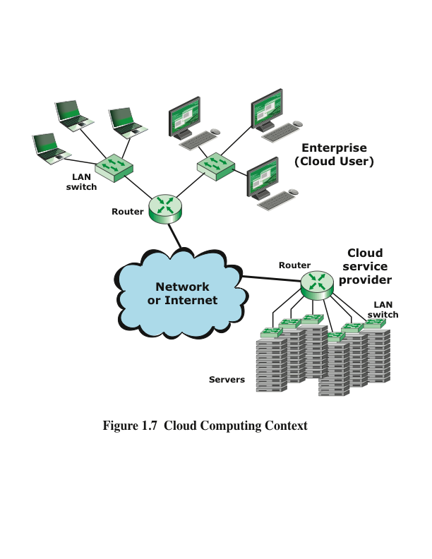
Notes:
Figure 1.7 illustrates the typical cloud service context. An enterprise maintains
workstations within an enterprise LAN or set of LANs, which are connected by a
router through a network or the Internet to the cloud service provider. The cloud
service provider maintains a massive collection of servers, which it manages with a
variety of network management, redundancy, and security tools. In the figure, the cloud
infrastructure is shown as a collection of blade servers, which is a common architecture.

Slide 35
Benefits of Cloud Computing
Cloud computing provides:
Economies of scale
Professional network management
Professional security management
Another big advantage of using cloud computing to store your data and share it with others is that the cloud provider takes care of security
Unfortunately the customer isn’t always protected
There have been a number of security failures among cloud providers
Notes:
Cloud computing provides economies of scale, professional network management,
and professional security management. These features can be attractive to companies
large and small, government agencies, and individual PC and mobile users. The
individual or company needs to pay only for the storage capacity and services they
need. The user, be it company or individual, does not have the hassle of setting up a
database system, acquiring the hardware they need, doing maintenance, and backup
up the data; all this is part of the cloud service.
In theory, another big advantage of using cloud computing to store your data and
share it with others is that the cloud provider takes care of security. Alas, the customer
is not always protected. There have been a number of security failures among cloud
providers. Evernote made headlines in early 2013 when it told all of its users to reset
their passwords after an intrusion was discovered. Cloud security is addressed in
Chapter 16, “Security.”

Slide 36
Cloud Networking
Refers to the networks and network management functionality that must be in place to enable cloud computing
Many cloud computing solutions rely on the Internet, but that is only a piece of the networking infrastructure
One example is the provisioning high-performance/high-reliability networking between the provider and subscriber
In this case, some or all of the traffic between an enterprise and the cloud bypasses the Internet and uses dedicated private network facilities owned or leased by the cloud service provider
More generally, cloud networking refers to the collection of network capabilities required to access a cloud, including:
Making use of specialized services over the Internet
Linking enterprise data centers to a cloud
Using firewalls and other network security devices at critical points to enforce access security policies
Notes:
Cloud networking refers to the networks and network management functionality that
must be in place to enable cloud computing. Many cloud computing solutions rely on
the Internet, but that is only a piece of the networking infrastructure.
One example of cloud networking is the provisioning high-performance/highreliability
networking between the provider and subscriber. In this case, some or
all of the traffic between an enterprise and the cloud bypasses the Internet and uses
dedicated private network facilities owned or leased by the cloud service provider.
More generally, cloud networking refers to the collection of network capabilities
required to access a cloud, including making use of specialized services over the
Internet, linking enterprise data centers to a cloud, and using firewalls and other
network security devices at critical points to enforce access security policies.

Slide 37
Cloud Storage
Can be thought of as a subset of cloud computing
Consists of database storage and database applications hosted remotely on cloud servers
Enables small businesses and individual users to take advantage of data storage that scales with their needs and to take advantage of a variety of database applications without having to buy, maintain, and manage the storage assets
Notes:
We can think of cloud storage as a subset of cloud computing. In essence, cloud
storage consists of database storage and database applications hosted remotely on
cloud servers. Cloud storage enables small businesses and individual users to take
advantage of data storage that scales with their needs and to take advantage of a
variety of database applications without having to buy, maintain, and manage the
storage assets.

Slide 38
Network Convergence
Refers to the merger of previously distinct telephony and information technologies and markets
You can think of this convergence in terms of a three-layer model of enterprise communications:
Application convergence
These are seen by the end users of a business
Convergence integrates communications applications with business applications
Enterprise services
At this level, the manager deals with the information network in terms of the services that must be available to ensure that users can take full advantage of the applications that they use
Infrastructure
The network and communications infrastructure consists of the communication links, LANs, WANs, and Internet connections available to the enterprise
A key aspect of convergence at this level is the ability to carry voice, image, and video over networks that were originally designed to carry data traffic
Notes:
Network convergence refers to the merger of previously distinct telephony and
information technologies and markets. You can think of this convergence in terms of
a three-layer model of enterprise communications:
■ Application convergence: These are seen by the end users of a business.
Convergence integrates communications applications, such as voice calling
(telephone), voice mail, e-mail, and instant messaging, with business applications,
such as workgroup collaboration, customer relationship management,
and back-office functions. With convergence, applications provide rich features
that incorporate voice, data, and video in a seamless, organized, and
value-added manner. One example is multimedia messaging, which enables
a user to use a single interface to access messages from a variety of sources
(for example, office voice mail, e-mail, SMS text messages, and mobile voice
mail).
■ Enterprise services: At this level, the manager deals with the information
network in terms of the services that must be available to ensure that users can
take full advantage of the applications that they use. For example, network
managers need to make sure that appropriate privacy mechanisms and authentication
services are in place to support convergence-based applications. They
may also be able to track user locations to support remote print services and
network storage facilities for mobile workers. Enterprise network management
services may also include setting up collaborative environments for various
users, groups, and applications and QoS provision.
■ Infrastructure: The network and communications infrastructure consists of
the communication links, LANs, WANs, and Internet connections available to
the enterprise. Increasingly, enterprise network infrastructure also includes private/
public cloud connections to data centers that host high-volume data storage
and web services. A key aspect of convergence at this level is the ability
to carry voice, image, and video over networks that were originally designed
to carry data traffic. Infrastructure convergence has also occurred for networks
that were designed for voice traffic. For example, video, image, text, and data
are routinely delivered to smartphone users over cell phone networks.

Slide 39
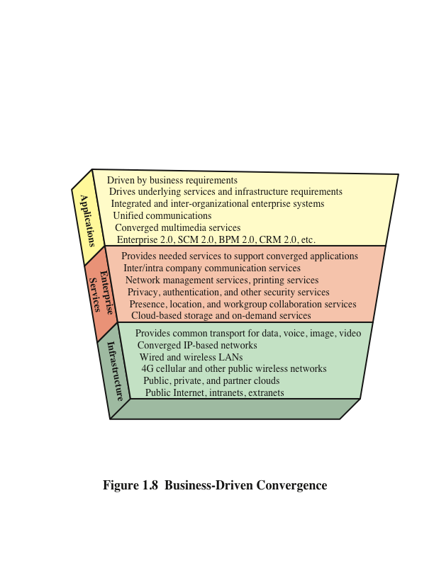
Notes:
Figure 1.8 illustrates the major attributes of the three-layer model of enterprise
communications. In simple terms, convergence involves moving an organization’s
voice, video, and image traffic to a single network infrastructure. This often involves
integrating distinct voice and data networks into a single network infrastructure
and extending the infrastructure to support mobile users. The foundation of this
convergence is packet-based transmission using the Internet Protocol (IP). Using IP
packets to deliver all varieties of communications traffic, sometimes referred to as
everything over IP, enables the underlying infrastructure to deliver a wide range of
useful applications to business users.

Slide 40
Unified Communications (UC)
Focuses on the integration of real-time communication services to optimize business processes
IP is the cornerstone on which UC systems are built
Key elements of UC include:
UC systems typically provide a unified user interface and consistent user experience across multiple devices and media
UC merges real-time communications services with non-real-time services and business process applications
Notes:
A concept related to network convergence is unified communications (UC).
Whereas enterprise network convergence focuses on the consolidation of traditionally
distinct voice, video, and data communications networks into a common infrastructure,
UC focuses on the integration of real-time communication services to optimize
business processes. As with converged enterprise networks, IP is the cornerstone on
which UC systems are built. Key elements of UC include the following:
1. UC systems typically provide a unified user interface and consistent user experience
across multiple devices and media.
2. UC merges real-time communications services with non-real-time services and
business process applications.

Slide 41
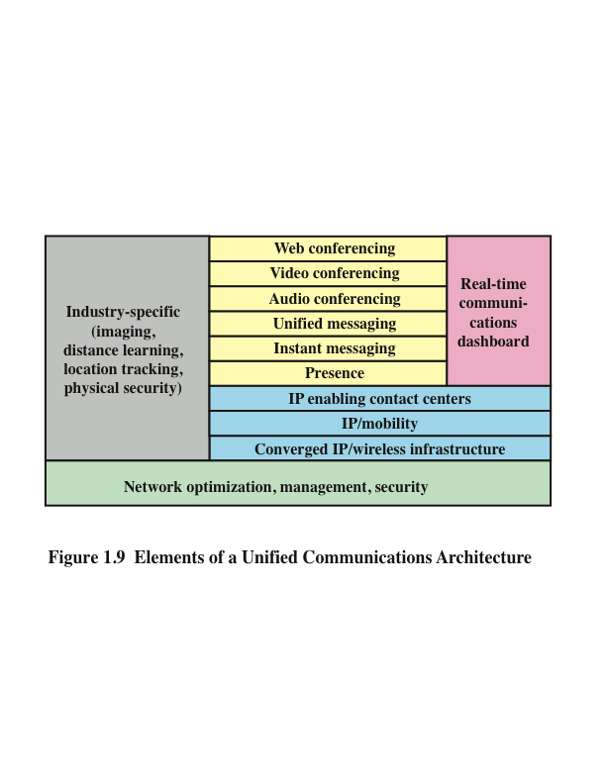
Notes:
Figure 1.9 shows the typical components of a UC architecture and how they relate to
one another.
The key elements of this architecture are as follows:
■ Real-time communications (RTC) dashboard: An RTC dashboard is
a key component of UC architecture. This is the element that provides UC
users with a unified user interface across communication devices. Ideally,
the user has a consistent interface no matter what communication device the
user is currently using, whether it is a cell phone, wireless tablet computer,
desktop system, or office telephone attached to the corporate private branch
exchange (PBX). As you can see in Figure 1.9, RTC dashboards provide
access to real-time communication services such as instant messaging, audio
and video conferencing, and interactive whiteboards; RTC dashboards also
provide access to non-real-time services such as unified messaging (e-mail,
voice mail, fax, and SMS) in unified view. An RTC dashboard includes
presence information about co-workers and partners so that users can know on
the fly which colleagues are available to communicate or join a collaborative
communication session. RTC dashboards have become necessities in
organizations that require high levels of communication and collaboration to
support business processes.
■ Web conferencing: Refers to live meetings or presentations in which participants
access the meeting or presentation via a mobile device or the web, either
over the Internet, or corporate intranet. Web conferences often include data
sharing through web-connected interactive white boards (IWBs).
■ Audio conferencing: Also called conference calling, refers to a live meeting
in which participants are linked together for audio transmission and reception. A
participant may be on a landline, mobile phone, or at a “softphone”—a computer
equipped with microphone and speaker.
■ Unified messaging: Unified messaging systems provide a common repository
for messages from multiple sources. It allows users to retrieve saved
e-mail, voice mail, and fax messages from a computer, telephone, or mobile
device. Computer users can select and play voice-mail recordings that appear
in their unified messaging inboxes. Telephone users can both retrieve voice
mail and hear text-to-voice translations of e-mail messages. Messages of any
type can be saved, answered, filed, sorted, and forwarded. Unified messaging
systems relieve business users from having to monitor multiple voice mailboxes
by enabling voicemail messages received by both office phones and cell phones
to be saved to the same mailbox. With UC, users can use any device at any time
to retrieve e-mail or voice-mail from unified messaging mailboxes.
■ Instant messaging (IM): Real-time text-based messaging between two or
more participants. IM is similar to online chat because it is text-based and
exchanged bidirectionally in real time. IM is distinct from chat in that IM
clients use contact (or buddy) lists to facilitate connections between known
users, whereas online chat can include text-based exchanges between anonymous
users.
■ Video teleconferencing (VTC): Videoconferencing allows users in two
or more locations to interact simultaneously via two-way video and audio
transmission. UC systems enable users to participate in video conferences via
desktop computers, smartphones, and mobile devices.
■ Presence: The capability to determine, in real time, where someone is,
how that person prefers to be reached, and even what the person is currently
doing. Presence information shows the individual’s availability state before
co-workers attempt to contact them person. It was once considered simply an
underlying technology to instant messaging (for example, “available to chat”
or “busy”) but has been broadened to include whether co-workers are currently
on office or mobile phones, logged in to a computer, involved in a video
call or in a meeting, or out of the office for lunch or vacation. A co-worker’s
geographic location is becoming more common as an element in presence
information for a number of business reasons, including the capability to
quickly respond to customer emergencies. Business has embraced presence
information because it facilitates more efficient and effective communication.
It helps eliminate inefficiencies associated with “phone tag” or composing and
sending e-mails to someone who could more quickly answer a question over
the phone or with a quick meeting.
■ IP enabling contact centers: Refers to the use of IP-based unified communications
to enhance customer contact center functionality and performance.
The unified communications infrastructure makes use of presence technology
to enable customers and internal enterprise employees to be quickly connected
to the required expert or support person. In addition, this technology supports
mobility, so that call center personnel need not be located at a particular office
or remain in a particular place. Finally, the UC infrastructure enables the call
center employee to quickly access other employees and information assets,
including data, video, image, and audio.
■ IP/mobility: Refers to the delivery of information to and collection of information
from enterprise personnel who are usually mobile, using an IP network
infrastructure. In a typical enterprise, upward of 30 percent of employees use
some form of weekly remote access technology in the performance of their
jobs.
■ Converged IP/wireless infrastructure: A unified networking and
communications-based IP packet transfer to support voice, data, and video
transmission and can be extended to include local- and wide-area wireless
communications. UC-enabled mobile devices are able to switch between Wi-Fi
and cellular systems in the middle of a communication session. For example, a
UC user could receive a co-worker’s call via a smartphone connected to Wi-Fi
network at home, continue the conversation while driving to work over a cellular
network connection, and could end the call at the office while connected
to the business’s Wi-Fi network. Both handoffs (home Wi-Fi to cellular and
cellular to office Wi-Fi) would take place seamlessly and transparently without
dropping the call.

Slide 42
End of Chapter 1

